Slide 1

GENDER CLASSIFICATION BASED ON FINGERPRINT USING SVM AND CNN DOMAIN:MACHINE LEARNING
BATCH 22
GUIDE:
Dr. M. SANGEETHA,M.Tech,Ph.D.,
PRESENTED BY:
B . NithishKumar [211422104]
R . Malleshvaran [211422104265]

Slide 2
INTRODUCTION
Gender classification is a critical element in many biometric applications. Traditionally, fingerprints have been used for personal identification, but recent advancements in technology have enabled us to extract even more information. By analyzing the patterns and ridges within fingerprints, we can now predict gender with a notable degree of accuracy. This process offers a non-invasive, cost-effective method for enhancing security, personalization, and demographic data collection, making it a valuable tool in fields such as forensics, healthcare, and social sciences.

Slide 3
ABSTRACT
Information on the gender of a person plays a vital role in crime investigation, authentication and statistical report on the visitors.
As a novel method, the optimal score assignment (OSA) method is proposed to classify gender. An optimal score is calculated for male and female from the internally collected fingerprint database.
Fingerprints are collected under four age groups and all the fingers are scanned. For the fingerprint image ‘I’ for which gender is to be identified, scores are assigned for ridge count and fingertip assuming that the given image is male.

Slide 4
Year | Author | Title of the paper | Methodology | Proposed system
2019 | Anju Narayanan | Gender Detection and Classification from Fingerprints Using Pixel Count | involves collecting and preprocessing fingerprint images, calculating the number of ridge and valley pixels, and extracting additional features related to pixel distribution | enhance the model by incorporating additional features such as ridge density and texture analysis to capture more complex.
2020 | Gnanasivam. p | Fingerprint Gender Classification using Wavelet Transform and singular value | High-quality fingerprint images will be collected from a diverse group of individuals, ensuring a balanced dataset in terms of gender, age, and ethnicity. | Noise Reduction: The images will undergo filtering to remove noise.
2021 | G. Jayakalaa, Dr. L.R.Sudha | Gender Classification Based on Fingerprint Analysis | Data Collection ,Feature Extraction ,Machine Learning Models , Testing and Evaluation, Security Systems , Challenges and Conisdered | The proposed system aims to classify the gender of individuals based on the analysis of their fingerprints.
2022 | Anjali Mishra, Prof. Sweta Jain | A review on identification of gender using fingerprints | After this stage, gender-related features were extracted by 5 efficient features for fingerprints, such as RT VTR, LBP, Entropy, DCT, Minutiae points then this all Followed by classification stage as kNN, Support Vector Machine (SVM) | Males are with high ridges whereas females having low. We can identify gender by extracting the various features from the fingerprints like calculating the ridge-density, ridges, minutiae, finding fingertip-size (FTS)
2023 | J. Serin | Gender Classification from Fingerprint Using Hybrid CNN-SVM | involves collecting fingerprint images, preprocessing them, and using (CNN) to extract deep features. These features are then classified by a Support Vector Machine (SVM) to determine gender. | using feature selection methods and cross-validation can ensure the model is robust and efficient, while optimizing the CNN and SVM architectures can reduce computational complexity and processing time.

Slide 5
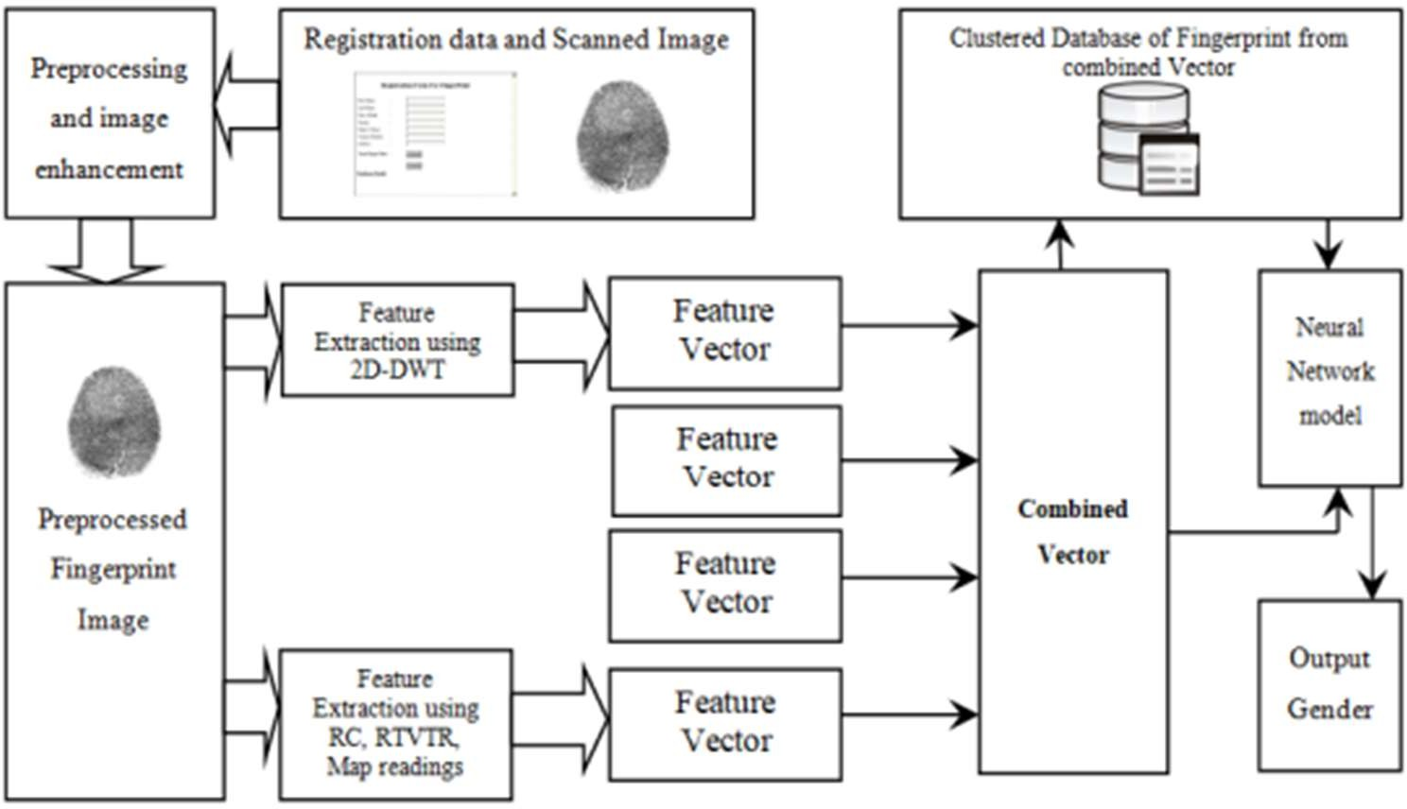
ARCHITECTURE OVERVIEW

Slide 6
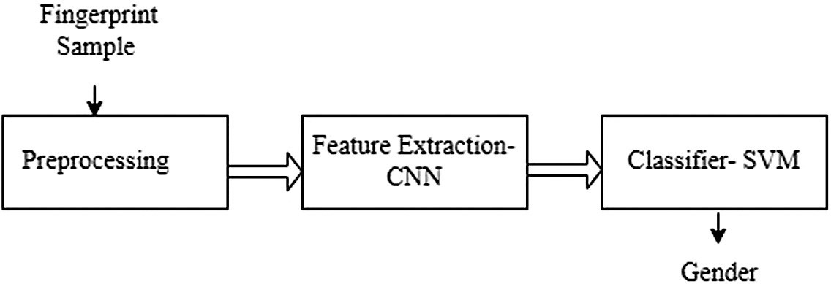
WORK FLOW DIAGRAM

Slide 7
HARDWARE REQUIREMENT
Basic Requirements : Processor (CPU)
Multi-core processor: Intel i5/i7 or AMD Ryzen
High clock speed
Memory (RAM):Minimum 8 GB or16 GB.
Storage: Solid State Drive (SSD)
Size: 256 GB

Slide 8
SOFTWARE REQUIREMENT
Development Environment
Integrated Development Environment (IDE):
Sypder: A powerful for Python.
Anaconda Navigator : Ideal for interactive development and visualization.
VS Code: Versatile and lightweight IDE supporting multiple languages and extensions.

Slide 9
METHODOLOGY
Ridge Density Analysis: The number of ridges in a certain area of the fingerprint differs between males and females, with females generally having higher ridge density.
Frequency Domain Analysis: Differences in the spatial frequency of fingerprint ridges are used to classify gender.
Minutiae-based Features: Analyzing specific minutiae points (ridge endings and bifurcations) to distinguish patterns between genders.
Machine Learning Models: Techniques like SVM, neural networks, or random forest classifiers can be trained on extracted fingerprint features to predict gender.
Image Processing: Pre-processing steps like binarization, segmentation, and thinning are used to prepare fingerprint images for further analysis.

Slide 10
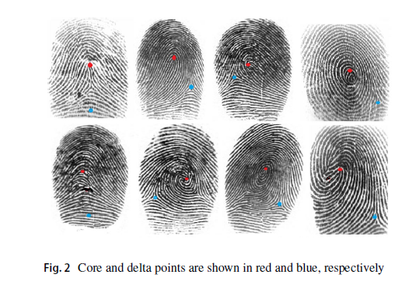
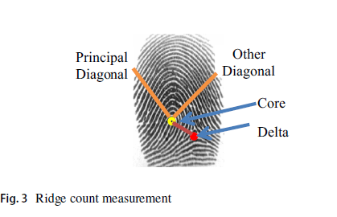
RIDGE COUNT MEASUREMENT

Slide 11
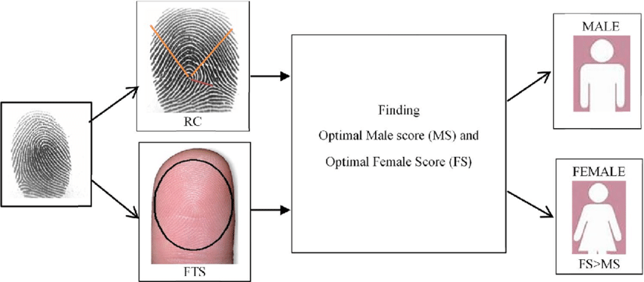
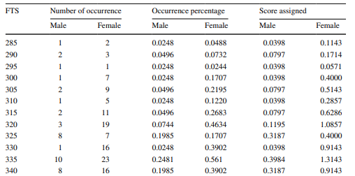
FINGERTIP SIZE VARIATION

Slide 12
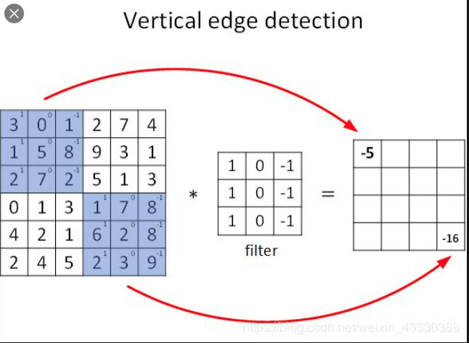
CONVOLUTIONAL NEURAL NETWORKS(CNN)
Convolutional Neural Networks (CNNs) process data by mimicking the visual processing of the human brain, starting with an input layer that represents data, such as images, as grids of pixel values. They apply a series of convolutional layers using filters to detect features in the data, producing feature maps that highlight patterns like edges or textures.

Slide 13
USAGE OF NEW TOOLS
Pandas: For data manipulation and analysis.
NumPy: For numerical computations.
Sypder: For python usage
Scikit-learn: For building, training, and evaluating the machine learning model.
Seaborn and Matplotlib: For visualization of data and results.
Pickle: For saving and loading the trained model.

Slide 14
JOURNAL
SOURCE : International Research Journal of Modernization in Engineering Technology and Science
TITLE : Fingerprint Based Gender Classification
AUTHORS : Prof. Aishwarya Vibhute, Sayali Bhise, Swapnali Bhise ,Rutuja Deokar
YEAR:2024
LINK : https://www.irjmets.com/uploadedfiles/paper

Slide 15
THANK YOU

